Slide 1

F25-082-R-ArthoCare
ArthoCare
Multimodal Flare Prediction and Self-Management Platform for
Rheumatoid Arthritis
Umema Ashar DS, Hamza Asad DS, Heer CS
Collaborator
Dr. Faisal Cheema
Physiotherapy Dept., GIMES
1

Slide 2
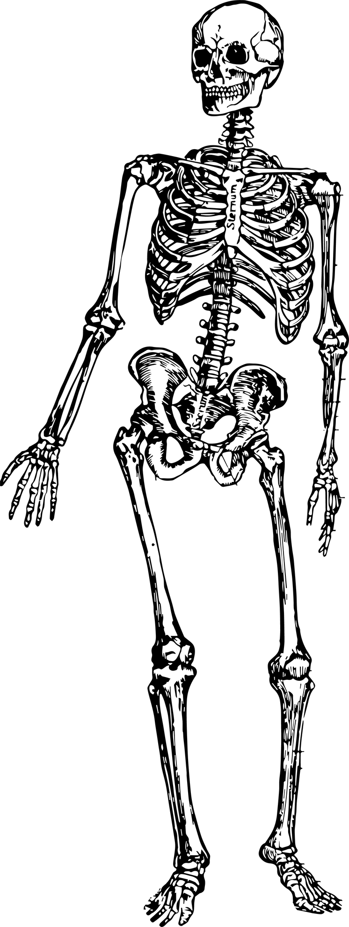
ARTHOCARE
Rheumatoid
Arthritis
2

Slide 3
ARTHOCARE
Why Flare Prediction Matters
Unpredictable flare-ups
Reduced quality of life
Episodic doctor visits
Patient need: continuous, personalized, real-time management
3

Slide 4
ARTHOCARE
The Impact
20M
2x
80%
RA affects s nearly 20 million people affected globally
(Source: Medical News Today)
RA patients are twice as likely to leave work within 10 years of diagnosis (Source: Rheumatology systematic review)
Flares affect 70–
80% of patients, leading to reduced mobility and QoL
(Source: Medical News Today)
4

Slide 5
ARTHOCARE
Research Taxonomy
Flare Prediction
5 PAPERS
Joint Range of Motion via Computer Vision
Mobile Health Apps and Personalized Recommendations
Association Between Weather and Chronic Pain
QoL & Clinical Integration
3 PAPERS
5 PAPERS
3 PAPERS
2 PAPERS
5
Notes:
Slide 1: Research Taxonomy
*"Our research focuses on RA flare prediction.
From the literature, we mapped out four main directions.
First, range of motion using computer vision.
Second, mobile health apps for lifestyle and self-management.
Third, weather and time-series data — which is also a dataset we might use.
And finally, studies on quality of life and clinical integration.
This taxonomy shows us the overall picture, and helps us see where different approaches fit."*
“From here, we selected key studies from each category

Slide 6
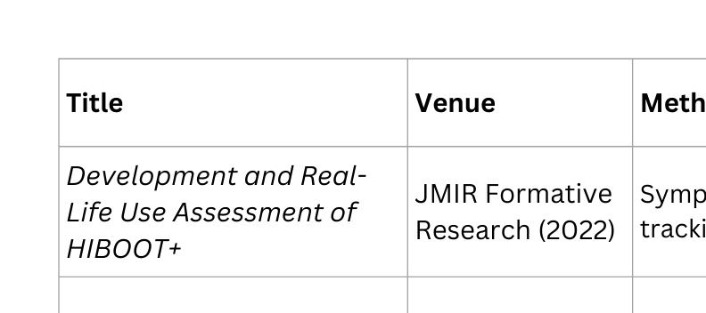
Literature Review
6
Notes:
"When we reviewed the existing work, we noticed four key areas.
First — Lifestyle tracking apps like HIBOOT+.
Their strength is that they allow patients to log symptoms, medications, and activity in real life. But the limitation is that they stop at tracking — there’s no prediction or proactive support.
Second — Weather-based studies, such as Cloudy with a Chance of Pain.
Their strength was scale — it was one of the largest studies linking weather to pain. But the weakness is that it only showed correlation, without a predictive framework.
Third — Biomechanics, especially pose estimation.
Here, the strength is accuracy: joint movements can be tracked with precision. But the gap is that these were small studies, and they never connected movement data to flare prediction.
And fourth — Machine learning models.
The strength is clear: they showed prediction is possible. But the weakness is that they relied mainly on self-reports, which limited accuracy and generalizability.
👉 So overall, while each of these approaches added important value, the weaknesses stand out. And it’s exactly these gaps that motivated us to design a more multimodal, predictive platform."

Slide 7
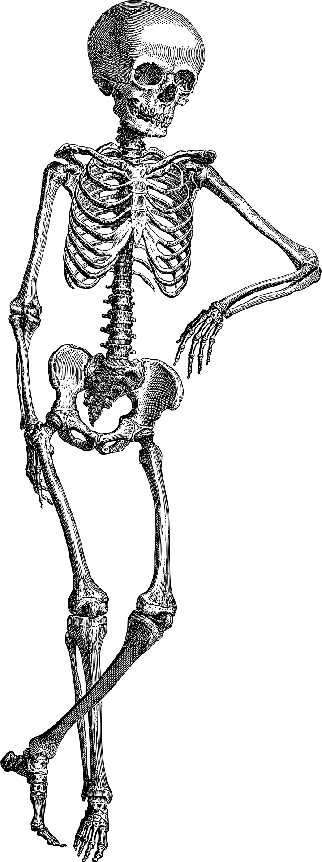
ARTHOCARE
Where Current Research Falls Short
Over-reliance on self-reported data
Lack of multi-factor integration
Neglect of biomechanical data
Limited predictive power
Weak patient self-management focus
Poor clinical integration
Lack of personalized recommendations
7
Notes:
"As you can see here, several gaps emerge across the literature — from over-reliance on self-reports, to lack of multi-factor integration, weak predictive power, and minimal clinical or patient support."
👉 Transition:
"These gaps bring us to the core problem we’re addressing."

Slide 8
ARTHOCARE
The Problem
Existing RA flare prediction approaches are fragmented—relying heavily on self-reported data, lacking integration of lifestyle, weather, and biomechanical factors, and offering limited support for patient self-management and clinical use.
8
Notes:
*"In short, current RA flare prediction methods are fragmented.
They depend too much on subjective data.
They fail to bring together the multiple factors that actually drive flares.
And they provide little value for patients or doctors.
This makes them less reliable, less actionable, and less useful in real-world care."*
“This problem statement naturally leads to some key research questions — which my teammate, Mr. Hamza, will now share with you.”

Slide 9
ARTHOCARE
Research Questions
What clinical, lifestyle, and environmental factors most strongly influence flare occurrence in RA?
How can we measure ROM of joints and use those measurements to predict the risk of an RA flare?
1
2
To what extent can a predictive model provide personalized and reliable flare risk estimates?
How can a digital self-management framework balance patient usability with clinical integration?
3
4
9

Slide 10
ARTHOCARE
Research Objectives
1
Identify clinical, lifestyle, and environmental factors
2
Incorporate objective biomechanical (movement) measurements
3
Develop a predictive model that estimates personalized flare risk
4
Establish a patient-centered self-management framework
10

Slide 11






ARTHOCARE
Application Modules
Patient Data Input
RALens
Weather Integration
Flare Prediction Engine
Personalized Recommendations
Disease Progress Dashboard
11

Slide 12



MODULE CONTRIBUTION
ARTHOCARE
RA-Lens
(Range of Motion)
Weather Module
Lifestyle & Demographics
Input: Patient video of joint movements
Resource: Expert ROM benchmarks, CV tools
Output: Detects stiff/limited joints
Input: Local weather data (temp, humidity, pressure)
Resource: Daily patient logs (pain, stiffness, etc)
Output: Identifies environmental flare triggers
Input: Demographics & lifestyle choices
Resource: NHANES dataset + patient surveys
Output: Baseline RA risk & personalized recommendations
12
Notes:
"When we reviewed the existing work, we noticed four key areas.
First — Lifestyle tracking apps like HIBOOT+.
Their strength is that they allow patients to log symptoms, medications, and activity in real life. But the limitation is that they stop at tracking — there’s no prediction or proactive support.
Second — Weather-based studies, such as Cloudy with a Chance of Pain.
Their strength was scale — it was one of the largest studies linking weather to pain. But the weakness is that it only showed correlation, without a predictive framework.
Third — Biomechanics, especially pose estimation.
Here, the strength is accuracy: joint movements can be tracked with precision. But the gap is that these were small studies, and they never connected movement data to flare prediction.
And fourth — Machine learning models.
The strength is clear: they showed prediction is possible. But the weakness is that they relied mainly on self-reports, which limited accuracy and generalizability.
👉 So overall, while each of these approaches added important value, the weaknesses stand out. And it’s exactly these gaps that motivated us to design a more multimodal, predictive platform."

Slide 13

Data Review
ARTHOCARE
RA-Lens
(Range of Motion)
Weather Module
Lifestyle & Demographics
WHERE
WHEN
WHO
13
Flare Prediction Model
Notes:
"When we reviewed the existing work, we noticed four key areas.
First — Lifestyle tracking apps like HIBOOT+.
Their strength is that they allow patients to log symptoms, medications, and activity in real life. But the limitation is that they stop at tracking — there’s no prediction or proactive support.
Second — Weather-based studies, such as Cloudy with a Chance of Pain.
Their strength was scale — it was one of the largest studies linking weather to pain. But the weakness is that it only showed correlation, without a predictive framework.
Third — Biomechanics, especially pose estimation.
Here, the strength is accuracy: joint movements can be tracked with precision. But the gap is that these were small studies, and they never connected movement data to flare prediction.
And fourth — Machine learning models.
The strength is clear: they showed prediction is possible. But the weakness is that they relied mainly on self-reports, which limited accuracy and generalizability.
👉 So overall, while each of these approaches added important value, the weaknesses stand out. And it’s exactly these gaps that motivated us to design a more multimodal, predictive platform."

Slide 14
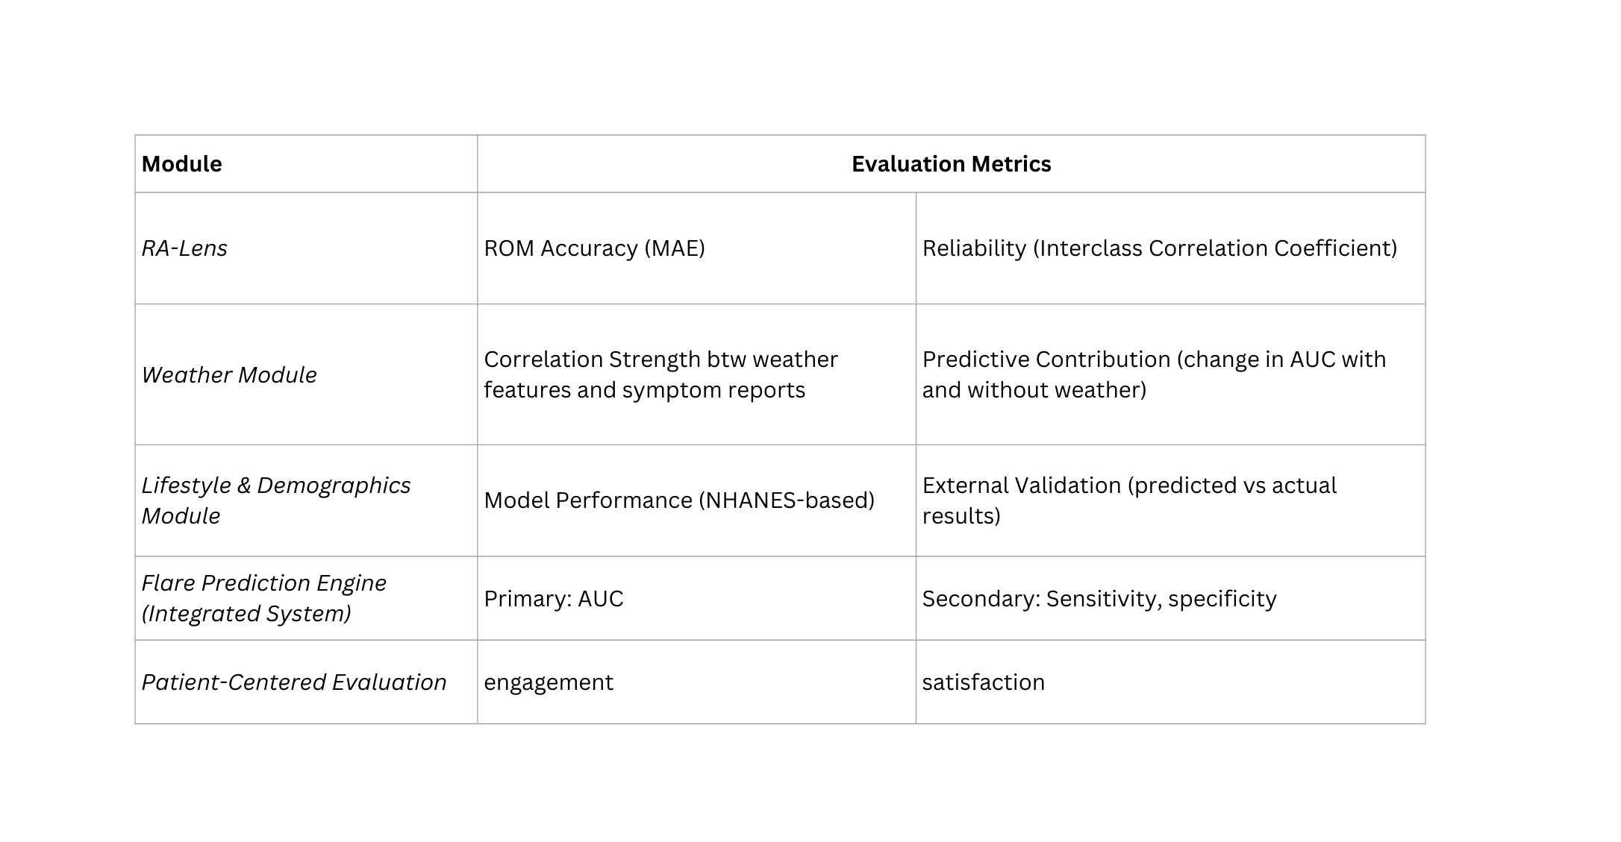
Evaluation Metrics
14

Slide 15









ARTHOCARE
Tentative Tech Stack
Data & ML Layer
Application Layer
Data & Storage
15

Slide 16





ARTHOCARE
Collaborator & Role
Physiotherapy Dept, GIMES
Data Collection
Clinical Expertise
Research Support
Pilot Testing & Feedback
16

Slide 17
ARTHOCARE
Project Roadmap
Q1
Fall-2025
Q2
Fall-2025
Q1
Spring-2026
Q2
Spring-2026
Literature
patient setup
NHANES baseline model
weather API prep
Start patient data collection
lifestyle modeling refinement
first ROM module
Combine weather, lifestyle, and ROM
build first predictive flare model
Validate model
finalize app
integrate recommendations
17

Slide 18
ARTHOCARE
Work distribution
Qtr 1 Fall 2025
Qtr 2 Fall 2025
Qtr 3 Spring 2026
Qtr 4 Spring 2026
Foundations & Baseline Development
Hamza: Dataset setup, Train a baseline RA susceptibility classifier
Umema: Lit review, baseline data collection with patients
Heer: weather API schema, basic app prototype
Data Collection & Modular Development
Hamza: improved RA susceptibility model, RAlens module
Umema: 2–3 weeks of preliminary data, Pilot test ROM accuracy
Heer: patient daily symptom logging, dashboard
Integration & Flare Prediction Prototype
Hamza: Expand ROM, integrate modules for app prototype v2
Umema: Combine lifestyle, weather, and ROM features into first integrated predictive model
Heer: weather-only flare prediction module
Final Validation & Smart Recommendation App
Hamza: statistical evaluation, research report
Umema: Finalize flare prediction model, deploy as exportable ML service
Heer: Add personalized recommendations, pilot usability testing
18

Slide 19
ARTHOCARE
References
Amprimo, C., et al. (2023). Computer vision for objective joint assessment in rheumatic diseases. Journal of Clinical Rheumatology, 29(4), 195-201.
Dixon, WG., et al. (2019). The role of weather in rheumatoid arthritis symptoms: A systematic review. Arthritis Care & Research, 71(10), 1301-1310.
Dixon, WG., et al. (2021). Environmental triggers and electronic health record integration for RA research. Annals of the Rheumatic Diseases, 80(6), 720-726.
Gandrup, J., et al. (2024). Predicting RA flares using patient-reported outcomes and machine learning. Rheumatology International, 44(2), 245-253.
Kalweit, D., et al. (2021). Machine learning approaches for predicting disease activity in rheumatoid arthritis. Arthritis & Rheumatology, 73(9), 1603-1612.
Norgeot, B., et al. (2021). Artificial intelligence and machine learning in rheumatology: A scoping review. Current Rheumatology Reports, 23(1), 5.
Vodencarevic, A., et al. (2021). Mobile health applications for rheumatoid arthritis self-management: A systematic review. Journal of Medical Internet Research, 23(7), e26207.
Wang, Y., et al. (2023). Deep learning-based joint pose estimation for musculoskeletal analysis. IEEE Transactions on Medical Imaging, 42(5), 1432-1442.
19

Slide 20
ARTHOCARE
Team
Umema Ashar 22i-2036
Hamza Asad 22i-1908
Heer 22i-2371
Supervisor:
Dr. Faisal Cheema
20

Slide 21
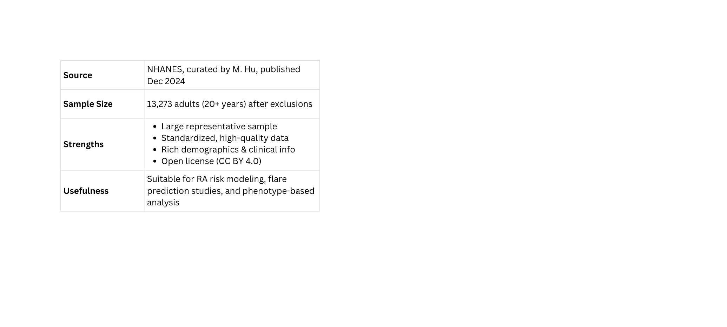
ARTHOCARE
Appendix
NHANES Dataset
Scope
Scope
Aim: Predict RA flare-ups using Weather + Lifestyle/Demographics + Range of Motion (RAlens) → deliver via a mobile app with personalized diet/exercise suggestions.
Study: ~50 RA patients, daily flare logging (several weeks), recruited via physiotherapy institute.
Key Components:
Weather: Validate “Cloudy with a Chance of Pain” (temp, humidity, rainfall, pressure → predictive models).
Lifestyle/Demographics: Pretrain on NHANES, fine-tune on Pakistani cohort (BMI, diet, comorbidities). variables: demographics, socioeconomic, BMI, physical activity, diet factors,
ROM (RAlens): Smartphone-based joint tracking (shoulder, elbow, wrist, hip, knee → early flare signals).
Integrated Model: Combine all 3 → predict flares 48–72h ahead.
Deliverable: Mobile app prototype with risk prediction + expert-curated recommendations.
21

Slide 22
ARTHOCARE
Appendix
What is GIMES giving us
NHANES is from the US
Scope
GIMES gives us real-world patient data (logs + ROM + demographics) and expert validation. NHANES is for pretraining, weather is external (API), but GIMES is your core ground-truth dataset that actually makes the model clinically credible.
NHANES is our pretraining dataset — it helps us learn general patterns of lifestyle and demographics. But before deploying, we’ll fine-tune on local patient data.
How We’re Predicting Joint Swelling & Pain
Scope
Weather Data
Range of Motion (RAlens – CV module):
Swelling → reduced mobility → abnormal ROM.
Example: If the knee is swollen, flexion/extension angles will deviate significantly from normal benchmarks.
Daily Symptom Logging (Patient-Reported Outcomes)
Patients log pain/stiffness/fatigue in a simple scale (0–10).
This provides ground truth labels for flare episodes (swelling/pain events).
Weather & Environmental Triggers: High humidity, pressure drops, temperature shifts are known to cause joint pain (also mentioned in the cloudy with a chance of pain paper)
Lifestyle & Comorbidities: BMI, smoking, physical inactivity, diabetes, hypertension, etc. → make patients more prone to flare-ups.
Patient Logs (GiMES): symptom diaries from RA patients, capturing pain, stiffness, fatigue, and flare patterns wrt time
Weather Data: External APIs providing daily weather variables (temperature, humidity, pressure, etc.).
Model Development: Guided by findings from the “Cloudy with a Chance of Pain” study to establish weather–symptom associations.
Validation: Trained models tested and validated against GiMES patient data.
22

